Slide 1

State Accounting
Business User Group (BUG)
Wednesday, March 27, 2019
9:00 AM – 10:30 AM
1526 K Street basement, Training Room/Development Center

Slide 2
Agenda
Welcome and Introductions
  Phil Olsen, State Accounting Administrator
  Andrea Kiichler, Financial Systems and Reports Coordinator
  Chad Pinger, Financial Systems and Reports Coordinator
Announcements
  General Announcements
  Use AS.State Accounting email for requests, do not send to individual email
  Deactivation of user IDs upon employee termination
  Generic A/R E-mails-Ann Martinez
Presentations
  State Accounting website/Training Guides/Accounting Manual
  Purchase order clean-up for encumbrances
  Purchase Order processes
  Fixed Assets
  Month End Close/Month End Close checklist
  Fund Summary by Fund (review of balance sheet accounts)
  Operating Investment Pool (OIP) review

Slide 3
Welcome and introductions
Phil Olsen, State Accounting Administrator
  Previously worked for Auditor’s Office for 13 years.
  Is a CPA with an MBA from NW Missouri state
Andrea Kiichler, Financial Systems and Reports Coordinator
  14 yr. State Employee, was at Dept. of Labor-UI Tax and OCIO-Procurement
  Bachelor’s Degree in Business Admin w/ Finance emphasis
  Lives in Seward, NE. with husband, 2 kids age 15 and 13, and 2 furbabies

Slide 4
Welcome and introductions
Chad Pinger, Financial Systems and Reports Coordinator
  3 ½ yrs. State Employee, was at Dept. of Health and Human Services
  Bachelor’s Degree in Business Administration, Finance.

Slide 5
Announcements
General Announcements
Use AS.State Accounting email for requests, do not send to individual email
Deactivation of user IDs upon employee Termination
Generic A/R E-mails-Ann Martinez

Slide 6
Purchase Order clean-up for Encumbrance process
Sheryl Hesseltine

Slide 7
What is an encumbrance?
Financial obligations which are chargeable to a specific biennium’s appropriation and for which a part of the appropriation is reserved.
Policy based on Statutes 81-138.01 – 81-138.04
In simple terms: an encumbrance is a reservation of an appropriation

Slide 8
Valid Encumbrance: 81-138.01
A purchase order is issued, but the goods and accompanying invoice were not received and paid during the same biennium
Goods or services were received, but an invoice has not been received and paid
Goods or services and an invoice were received, but payment could not be made during the same biennium
Notes:
For the first point, a service purchase order is not valid and will need to be received, closed out or cancelled prior to FEYE

Slide 9
Valid Encumbrance: 81-138.01
Salaries have been earned and are payable to the employees, but have not been paid as of the end of the biennium as a result of pay periods not being consistent with the end of the biennium, except that higher education institutions may encumber payrolls for the remainder of the summer session which is in progress at the end of the state’s biennium if they have been budgeted and appropriated in such manner.

Slide 10
Valid Encumbrance: 81-138.01
A written agreement for a grant or award to distribute aid was signed but was not paid during the same biennium.

Slide 11
Four ways to identify prior year obligations
Prior Year Voucher Without PO (P9 transaction)
Prior Year Voucher With PO (P9 transaction)
Manual Encumbrances (J9 transactions in PB ledger)
Automatic Encumbrances (Open purchase orders at year end)

Slide 12
Automatic Encumbrances
Purchase Orders that were open at June 30
State Accounting takes a “snapshot” of all open purchase orders at June 30 and records that information in the PC ledger

Slide 13
Automatic Encumbrances
It is very important that agencies complete a review of Open Purchase Orders before June 30 to ensure all orders are valid
These will be rolled over into July 1, 2019
If there is a problem, contact State Accounting by email at as.stateaccounting@nebraska.gov with a subject line of PO followed by the purchase order number, order type and line number

Slide 14
Purchase Orders
Run Open PO Detail by Branch/Plant Report (R43632) - Version NIS0004
  Cancel POs that are never going to be receipted.
  (note: when cancelling a PO be sure to Save)
    Menu Paths
    Accounting | Inquiries & Reports | Accounting Reports | Encumbrance/PO Reports | Open PO Detail by Branch/Plant
    Purchasing - Agencies | Inquiries & Reports | Purchasing Reports | Procurement Reports | Open PO Detail by Branch/Plant
Notes:
When cancelling a PO, it will ask if you are sure…choose Yes. Then it will bring up a screen for you to leave a comment on why PO is being cancelled. You will still need to save after this.

Slide 15
Cancel a Purchase Order
    Menu Path
Purchasing - Agencies | Purchase Orders - Agency | Work with Purchase Order
  Enter Order Number in QBE Line, Find
  Detail Revisions
  Form
  Cancel Order
  Will require an attachment on why cancelling – Save after this

Slide 16
Review amounts encumbered through PO
    Allotment Status Encumbrance Detail report:
Accounting| Inquiries & Reports| Accounting Reports | Encumbrance/PO Reports
  Choose Data Selection/Submit:
  For the Operand ‘Ledger Types’ should only be PA
  Enter Agency Number
  Can narrow it down by Program Number and/or Fund Type. To get everything for your agency, remove the lines for Program Number and Fund Type.

Slide 17
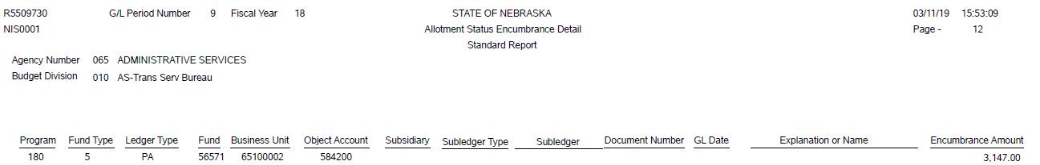
Review amounts encumbered through PO

Slide 18
Review amounts encumbered through PO
The Allotment Status Encumbrance Detail report gives you the total encumbered per account number (business unit/object code combination)
Inquire on the PA Commitment to find out which purchase order(s) is being encumbered for that account number

Slide 19
PA Commitment Inquiry
E1 path: Purchasing – Agencies | Inquiries & Reports | Purchasing Inquiries | PA Commitment Inquiry
Enter the Account Number in the QBE line, choose Order Summary and Find
Gives you the open amount, by purchase order, that should tie to your Allotment Status Encumbrance Detail report

Slide 20
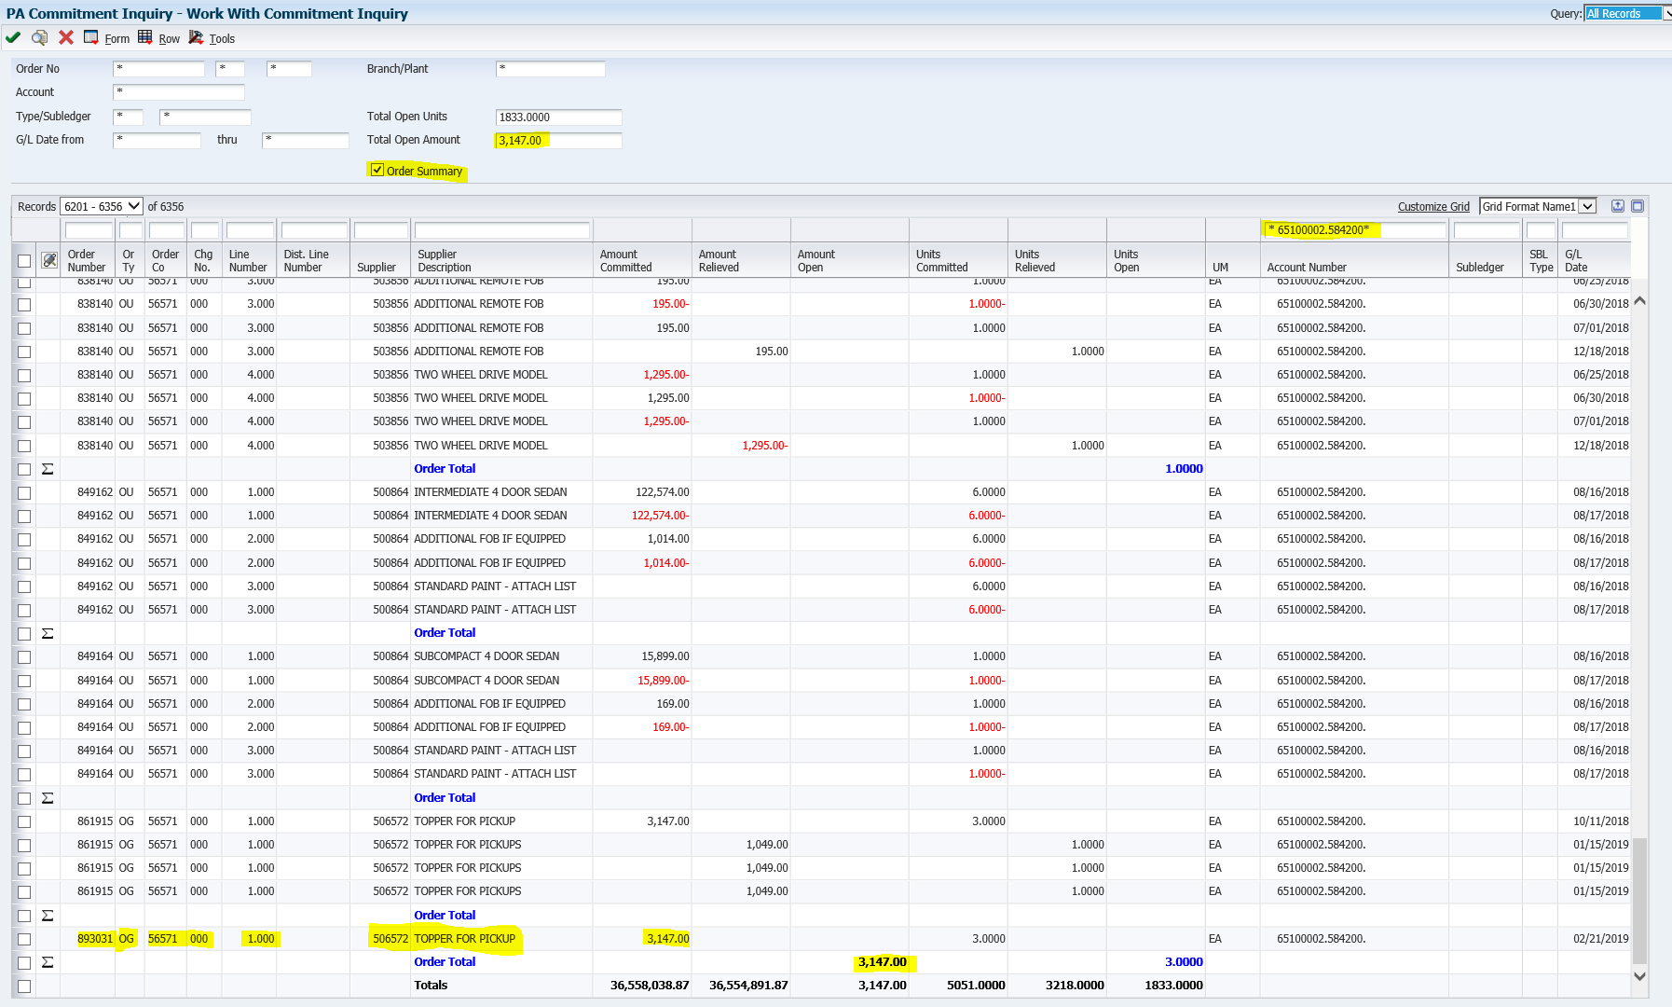
PA Commitment Inquiry

Slide 21
PA Commitment Inquiry
Is this a valid purchase order?
If not, follow your agency procedures for correction or cancellation
If the Open Amount that shows on the PA Commitment Inquiry screen does not match the Allotment Status Encumbrance Detail report, please contact State Accounting for assistance

Slide 22
Liquidating a Manual Encumbrance
This is only for the J9 transactions in the PB ledger
If you have created a manual encumbrance and it has already been paid, it must be liquidated.
Only liquidate manual encumbrance batches created by your agency. i.e. State Accounting creates and posts the payroll manual encumbrance for most agencies. These batches are liquidated by State Accounting.

Slide 23
Liquidating a Manual Encumbrance
E1 Training Guides
  http://link.nebraska.gov
  User Guides in Help section at top of page
  Payroll and Financial Center
  Budgeting
  Lesson 1: Working with Transactions-”Liquidating a Manual Encumbrance”
If using the void journal entry process, make sure to use a current G/L Date, and approve and post the batch before month end close.

Slide 24
Fixed Assets
Andrea Kiichler

Slide 25
Fixed Assets
Fixed Asset Facts
Creating Master Record
Posting Costs and Reports
The Big Picture

Slide 26
Fixed Asset Factuals
Created by payment to vendor by receipt from PO or JE
Coded to “58” Object Code
Payments posted to General Ledger, copy to Fixed Asset module
Fixed Assets= $1500 <
Exception: computers & firearms, all must be capitalized

Slide 27
Master Record
Beginning of Life for asset
*Tag number
*Cost Account
*Date acquired
*User defined Category Codes
*Text descriptions/remarks
Must be created for all Fixed Assets
E1 Guide for Creating Asset Master

Slide 28
Posting Costs & Checking it twice!
Receipting and Posting Costs = must establish relationship in same month
Splitting the Cost for Multiple Assets = Journal Entry (same month)
Friendly suggestion: no FA receipting last week of month
Allows time for Fixed Asset Coordinator to review receipts & JE’s for splits
E1 Guide for Posting & Split Asset Transaction Posting

Slide 29
Fixed Asset Reports = your besties!
Fixed Asset No Cost Integrity Report: listing of the Fixed Assets that have master records. These are the assets you have Tags for in E1.
Unposted Fixed Asset Report: Asset record not created yet
Matching game (reports as of 3/15)
Monthly review of these reports keeps you current
Must be cleared end of each month, and at FYE

Slide 30
Fixed Asset Fumbles
Oops! I didn’t post FA cost to asset in the same month!
*JE instruction and documentation
*documentation is invoice/PO/Packing Slips.
How do I know when to Pass on a cost?
*Most of the time, JE Credit side of transaction, but not always. Review cost of your assets first.
Uh Oh…..I just don’t get it! HELP!
*Email Andrea: andrea.kiichler@nebraska.gov

Slide 31
The Big Picture…why is this important?
State Accounting is responsible for the Comprehensive Annual Financial Report (CAFR)
  Includes all agencies assets and present value:
    Land & Buildings = $100,000+
    Equipment = $5,000+
    Construction in Progress = $100,000+
    (Make sure to use OC 587500)
Depreciation: processed by state accounting quarterly

Slide 32
Monthly Checklist
Shannon Muffly

Slide 33
Monthly Checklist
Website – under State Accounting Manual
Post voided batches promptly
Review unposted batches periodically
  Review and post unposted batches. Delete batches w/prior month’s G/L date
Post Purchase Order Receipt, type “O”, batches before creating vouchers

Slide 34
Monthly Checklist
All “O” batches must be posted or reversed before month is closed
  We will post current “O” batches at 5:00 p.m. on last working day of the month. If batch doesn’t post, we will process a reversal batch. No notice will be sent out and no post reports will be emailed to the agency.
Watch G/L dates
  Next months date should be used if 3 days before the end of a month
Make sure IB batches post
Review Unposted Fixed Assets

Slide 35
Month End Close
Shannon Muffly

Slide 36
When?
First business day of the month
Certain batches must be posted before noon
If not, we will approve and post
  Correcting entries can be done by the agency

Slide 37
Batch Types
O – PO/Contract Entries
7 – Actual Payroll Period Entries
# - Payroll Vouchers
N – Inventory
0 (Zero) – Manufacturing
G – General Accounting with fund type 99990
G – General Accounting with document type J1 (PCARD)

Slide 38
Batch Types
E – Asset Transfers
X – Depreciation Journal Entries
Z – Disposal Journal Entries
W – Manual Checks w/o match
K – A/P Checks
IB – settled invoice batches and unposted invoice batches (we delete)
RB – unposted cash receipt batches (we delete)
Unposted Voids

Slide 39
Deleting versus Voiding
Deleting is for transactions that haven’t been posted
Voiding is for transactions that have been posted

Slide 40
Voiding Transactions
If you void a transaction, the original batch MUST be approved and posted
For the last 3 business days of the month:
  The G/L date MUST be set to the next month
  Example: Current date is 2/26/19; set the G/L date for 3/1/19

Slide 41
OIP Review

Slide 42
OIP – Operating Investment Pool
Expect communication from me
Verify all funds and business units receiving interest
Annual Basis
Agencies need to verify by email with me
If changes need to be made, please submit an Investment Authorization Form
Email verification and/or Investment Authorization Form to: Shannon.Muffly@Nebraska.gov

Slide 43
Fund Summary by Fund Reviews

Slide 44
Fund Reviews
Monthly report on our website
Agencies should review on a monthly basis
Balance Sheet accounts (A/L) with negative balance
Cleared up by fiscal year end

Slide 45
Fund Requests
Location and Availability

Slide 46
Questions?
http://das.nebraska/accounting
  Administrator’s Correspondence; closing schedule
  Accounting Policies; state accounting manual (section 11, encumbrance policy)
http://www.nebraskalegislature.gov/laws/browse-statutes.php
statutes 81-138.01 – 81-138.04
Contact Info
  sheryl.hesseltine@nebraska.gov, 402-471-0610
  andrea.kiichler@nebraska.gov, 402-471-6621
  shannon.muffly@nebraska.gov, 402-471-0616
  kevin.le@nebraska.gov, 402-471-0622

